Slide 1

(IF216007)
Regresi: Regresi Linier sederhana dan variabel jamak, Regresi Polinomial dan Non-linier
oleh:
Wildan Budiawan Zulfikar, ST., M.Kom
Dian Sa’adillah Maylawati, S.Kom., MT
JURUSAN INFORMATIKA
FAKULTAS SAINS DAN TEKNOLOGI
UIN SUNAN GUNUNG DJATI BANDUNG
2022

Slide 2
Indikator Ketercapaian
Outcome Mata Kuliah
Outcome Program Studi
CLO-1: Mahasiswa mampu menjelaskan konsep pembelajaran mesin dan mengidentifikasi kebutuhan data dalam konsep pembelajaran mesin
PLO-02: Mampu menyelesaikan permasalahan dengan formulasi solusi efisien berbasis prinsip - prinsip komputasi
PLO-04: Memiliki pengetahuan dan pemahaman yang komprehensif pada area yang spesifik di bidang informatika
Outcome Perkuliahan
Mahasiswa mampu menjelaskan konsep regresi dalam menyelesaian masalah

Slide 3
Regression
Linear regressions are usually the first algorithms people learn in data science. Due to their popularity, a lot of analysts even end up thinking that they are the only form of regressions. The ones who are slightly more involved think that they are the most important among all forms of regression analysis.
The truth is that there are innumerable forms of regressions, which can be performed. Each form has its own importance and a specific condition where they are best suited to apply.

Slide 4
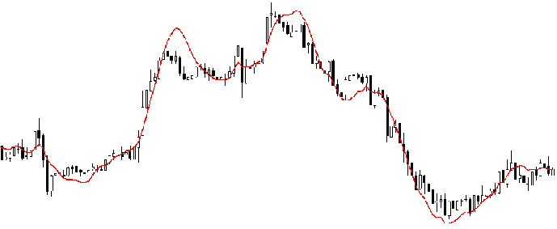
What is Regression Analysis?
Regression analysis is a form of predictive modelling technique which investigates the relationship between a dependent (target) and independent variable (s) (predictor).
This technique is used for forecasting, time series modelling and finding the causal effect relationship between the variables.
For example, relationship between rash driving and number of road accidents by a driver is best studied through regression.

Slide 5
Why do we use Regression Analysis?
There are multiple benefits of using regression analysis as follows:
It indicates the significant relationships between dependent variable and independent variable.
It indicates the strength of impact of multiple independent variables on a dependent variable.
Regression analysis also allows to compare the effects of variables measured on different scales, such as the effect of price changes and the number of promotional activities.
These benefits help market researchers / data analysts / data scientists to eliminate and evaluate the best set of variables to be used for building predictive models.

Slide 6
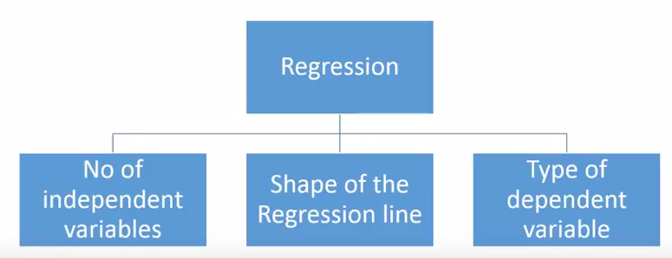
How many types of regression techniques do we have?
There are various kinds of regression techniques available to make predictions.
These techniques are mostly driven by three metrics (number of independent variables, type of dependent variables and shape of regression line).

Slide 7
Linear Regression

Slide 8
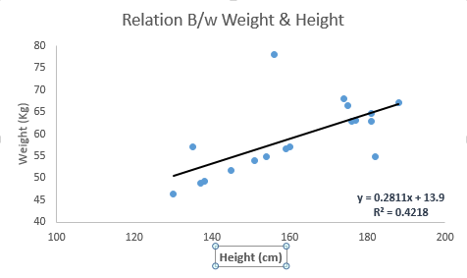
Linear Regression
It is one of the most widely known modeling technique. Linear regression is usually among the first few topics which people pick while learning predictive modeling. In this technique, the dependent variable is continuous, independent variable(s) can be continuous or discrete, and nature of regression line is linear.
Linear Regression establishes a relationship between dependent variable (Y) and one or more independent variables (X) using a best fit straight line (also known as regression line).
It is represented by an equation Y=a+b*X + e, where a is intercept, b is slope of the line and e is error term. This equation can be used to predict the value of target variable based on given predictor variable(s).

Slide 9
Simple Linear and Multiple Linear Regression
The difference between simple linear regression and multiple linear regression is that, multiple linear regression has (>1) independent variables, whereas simple linear regression has only 1 independent variable.

Slide 10
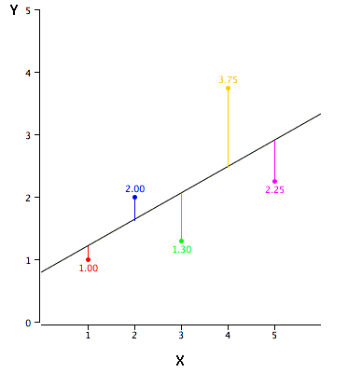
How to obtain best fit line
This task can be easily accomplished by Least Square Method.
It is the most common method used for fitting a regression line. It calculates the best-fit line for the observed data by minimizing the sum of the squares of the vertical deviations from each data point to the line.
Because the deviations are first squared, when added, there is no cancelling out between positive and negative values.

Slide 11
Important Points
There must be linear relationship between independent and dependent variables
Multiple regression suffers from multicollinearity, autocorrelation, heteroskedasticity.
Linear Regression is very sensitive to Outliers. It can terribly affect the regression line and eventually the forecasted values.
Multicollinearity can increase the variance of the coefficient estimates and make the estimates very sensitive to minor changes in the model. The result is that the coefficient estimates are unstable
In case of multiple independent variables, we can go with forward selection, backward elimination and step wise approach for selection of most significant independent variables.

Slide 12
Polynomial Regression

Slide 13

Polynomial Regression
Polynomial regression is a special case of linear regression where we fit a polynomial equation on the data with a curvilinear relationship between the target variable and the independent variables.
In a curvilinear relationship, the value of the target variable changes in a non-uniform manner with respect to the predictor (s).
Notes:
is Y the target,
x is the predictor,
𝜃0 is the bias,
and 𝜃1 is the weight in the regression equation

Slide 14
Polynomial Equation of Degree
This linear equation can be used to represent a linear relationship. But, in polynomial regression, we have a polynomial equation of degree n represented as:
The number of higher-order terms increases with the increasing value of n, and hence the equation becomes more complicated.
Notes:
𝜃0 is the bias,
𝜃1, 𝜃2, …, 𝜃n are the weights in the equation of the polynomial regression,
and n is the degree of the polynomial

Slide 15
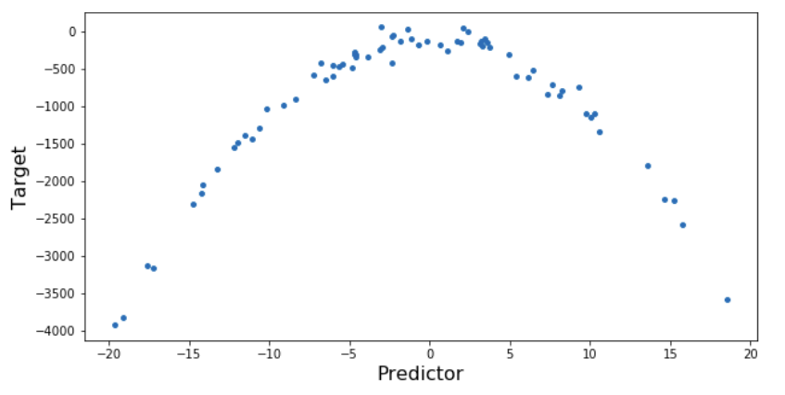
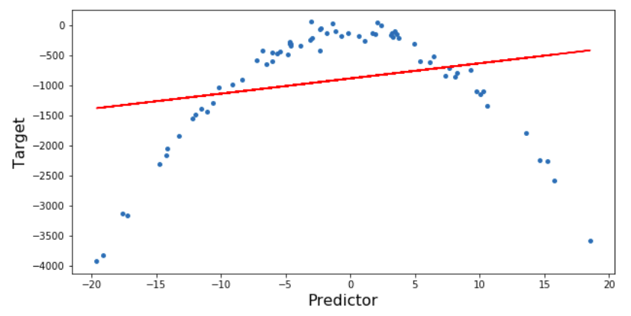
Polynomial Regression vs. Linear Regression
We will implement both the polynomial regression as well as linear regression algorithms on a simple dataset where we have a curvilinear relationship between the target and predictor.
Finally, we will compare the results to understand the difference between the two.
Linear Regression result:
Notes:
Here, you can see that the linear regression model is not able to fit the data properly and the RMSE (Root Mean Squared Error) is also very high.

Slide 16
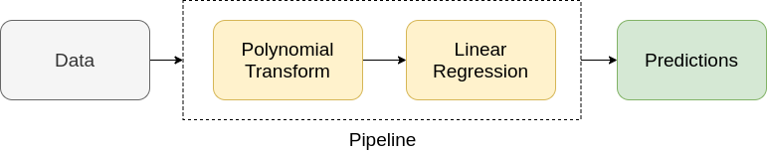
Polynomial Regression Steps
The implementation of polynomial regression is a two-step process. First, we transform our data into a polynomial using the PolynomialFeatures function from sklearn and then use linear regression to fit the parameters:

Slide 17
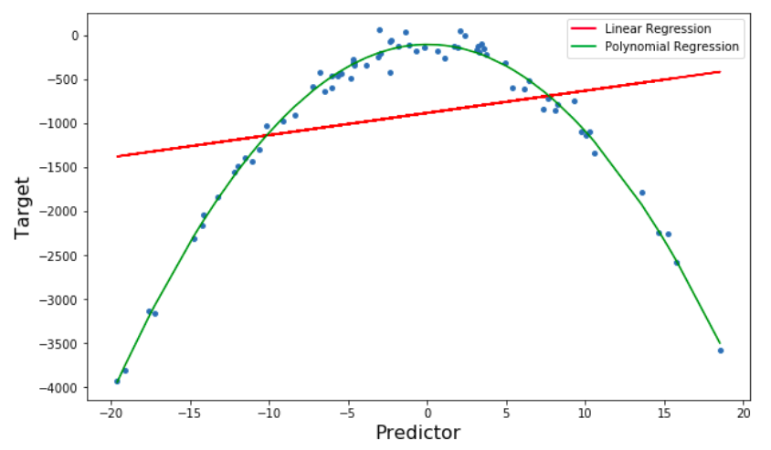
Polynomial Regression Result
Polynomial Regression is better at fitting the data than linear regression. Also, due to better-fitting, the RMSE of Polynomial Regression is way lower than that of Linear Regression.

Slide 18
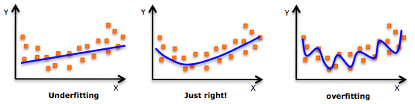
Important Points
While there might be a temptation to fit a higher degree polynomial to get lower error, this can result in over-fitting. Always plot the relationships to see the fit and focus on making sure that the curve fits the nature of the problem.
Especially look out for curve towards the ends and see whether those shapes and trends make sense. Higher polynomials can end up producing wierd results on extrapolation.

Slide 19
Logistic Regression

Slide 20
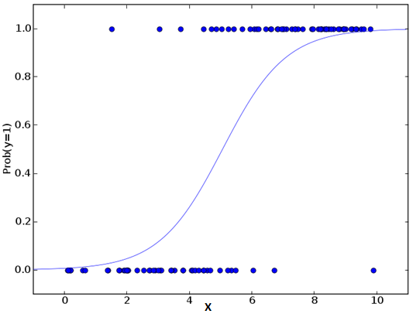
Logistic Regression
Logistic regression is used to find the probability of event=Success and event=Failure. We should use logistic regression when the dependent variable is binary (0/ 1, True/ False, Yes/ No) in nature.
Since we are working here with a binomial distribution (dependent variable), we need to choose a link function which is best suited for this distribution.
It is logit function. In the equation above, the parameters are chosen to maximize the likelihood of observing the sample values rather than minimizing the sum of squared errors (like in ordinary regression).

Slide 21
Important Points
Logistic regression is widely used for classification problems
Logistic regression doesn’t require linear relationship between dependent and independent variables. It can handle various types of relationships because it applies a non-linear log transformation to the predicted odds ratio
To avoid over fitting and under fitting, we should include all significant variables. A good approach to ensure this practice is to use a step wise method to estimate the logistic regression
It requires large sample sizes because maximum likelihood estimates are less powerful at low sample sizes than ordinary least square
If the values of dependent variable is ordinal, then it is called as Ordinal logistic regression
If dependent variable is multi class then it is known as Multinomial Logistic regression.

Slide 22
Other Regression Techniques

Slide 23
Other Regression Techniques
Stepwise Regression
Ridge Regression
Lasso Regression
ElasticNet Regression

Slide 24
How to select the right regression model?

Slide 25
Tugas Kelas Teori dan Praktikum
Review hasil riset/jurnal/prosiding mengenai penggunaan berbagai teknis regresi! (linear, logistic, polynomial, dll)!
Submit Jawaban di LMS Kelas Teori dan Praktikum

Slide 26

Referensi
1. Donald Hearn, M. Pauline Baker. Computer Graphics C Version. Prentice-Hall. 1997 (Pustaka Utama)
2. Max K. Agoston. Computer Graphics and Geometric Modeling : Implementation and Algorithms. Springer (Pustaka Pendukung)
3. Edhi Nugroho. Grafika Komputer (Teori dan Praktek) menggunakan Delphi dan OpenGL (Pustaka Pendukung)
4. Achmad Basuki & Nana Ramadijanti. 2016. Grafika Komputer –Teori Dan Implementasi, Penerbit ANDI: Yogyakarta (Pustaka Pendukung)
5. Pulung Nurtantio Andono & T. Sutoyo. Konsep Grafika Komputer, Penerbit ANDI: Yogyakarta (Pustaka Pendukung)
6. www.opengl.org (Pustaka Utama)
7. https://www.microsoft.com/en-us/download/search.aspx?q=directx (Pustaka Pendukung)8.https://unity3d.com/ (Pustaka Pendukung)
8. Edward Angel, Interactive Computer Graphics: A Top-Down Approach with OpenGL 2nd, Addison Wesley, 2005.
9. John F. Hughes, Andries Van Dam, Morgan Mcguire, David F. Sklar, James D. Foley, Steven K. Feiner, Kurt Akeley, Computer Graphics: Principles and Practice (3 rd edition), Addison-Wesley, 2014

